Slide 1

ATTITUDES
Week 4 Miss Aqsa Fayyaz Lecturer-Psychology Science and Humanities

Slide 2
Learning objectives
Attitudes
Definition and nature.
How attitudes develop and changes?
How attitudes influence on our behavior?

Slide 3
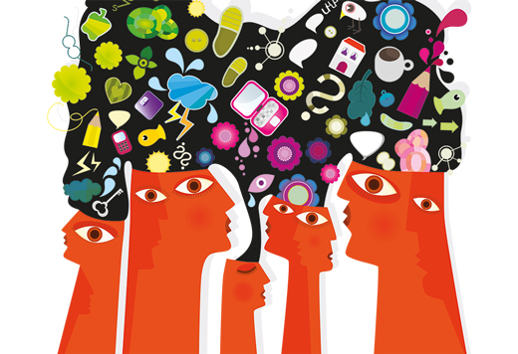
Social Psychology
Attitudes are studied in Social Psychology.
Social psychology is the scientific study of how people think, influence, and relate to one another.

Slide 4
Social Psychology
According to psychologist Gordon Allport, social psychology uses scientific methods to understand and explain “How the thoughts, feelings, and behavior of individuals are influenced by the actual, imagined, or implied the presence of other human beings”.

Slide 5
Actual Presence of people affecting the individual:
Example: Response of cricket players may become different when fans of some opposing team shout and make loud noises to divert attention of the players.
Similarly, your behavior will be changed if you notice that someone is watching you.
Imagined Presence of people affecting the individual
Example: if your parents have prohibited you from smoking, and you start smoking in a party on peer pressure, does their imagined presence affect your behavior?
Implied Presence of people affecting the individual:
If you have an experience of driving on the motorway, you would have noticed that signs of specific speed limit make you conscious.
2. In shopping stores sometime posters indicate that “You are being watched”...
All of this makes you self ware and brings a change in your behavior.

Slide 6
HISTORY OF SOCIAL PSYCHOLOGY
Plato referred to the idea of the "crowd mind," and concepts such as “social loafing” and “social facilitation” which were introduced in the late 1800s.

Slide 7

Crowd-mind
Emerges when formation of a crowd causes fusion of individual minds into one collective mind.
Members of the crowd lose their individuality.

Slide 8
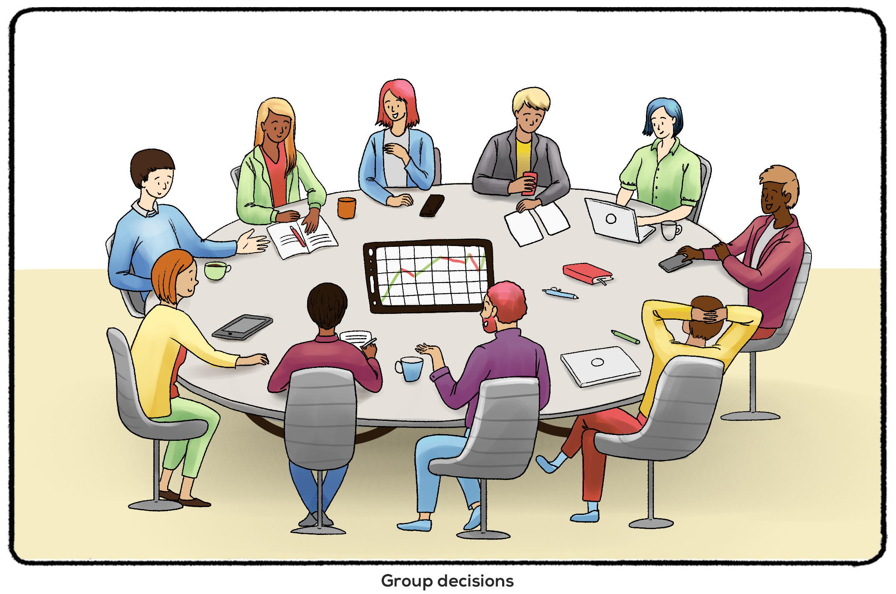
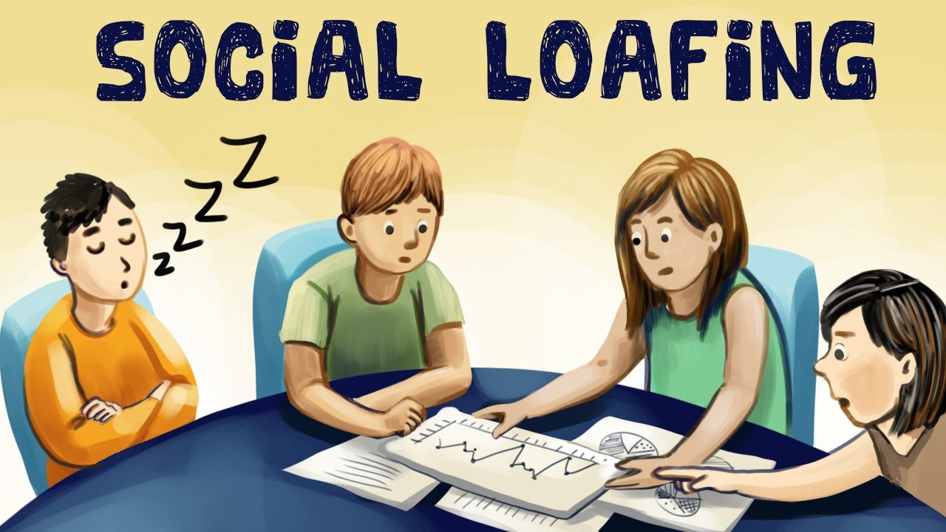
Social Loafing
Social loafing – Tendency for people in a group to exert less effort when pooling their efforts toward attaining a common goal than when individually accountable
Causes
Acting as part of group and feeling less accountable
Feeling individual contribution does not matter
Taking advantage when there is lack of identification with group

Slide 9
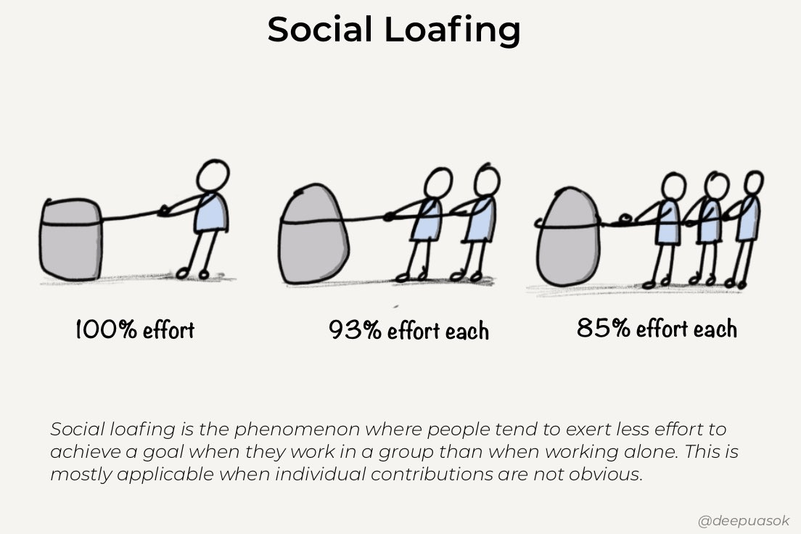
Examples: Tug of war, group homework projects, and an entertainer asking an audience to scream are all examples of social loafing because as you add more people to a group, the total group effort declines.
Notes:
https://monday.com/blog/teamwork/social-loafing/

Slide 10

Social facilitation is the idea that a person’s performance changes when they are around others versus when they are alone.
Improving performance on easy or well-learned tasks but decreasing it on difficult ones.
Example: Crowd encourage a team playing well.

Slide 11
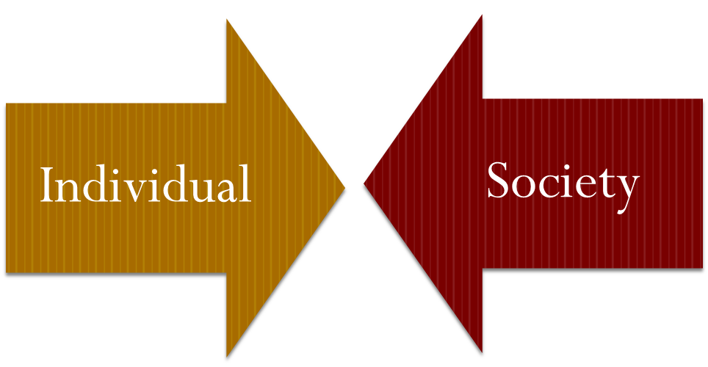
Social Psychology: Interpersonal level of analysis

Slide 12
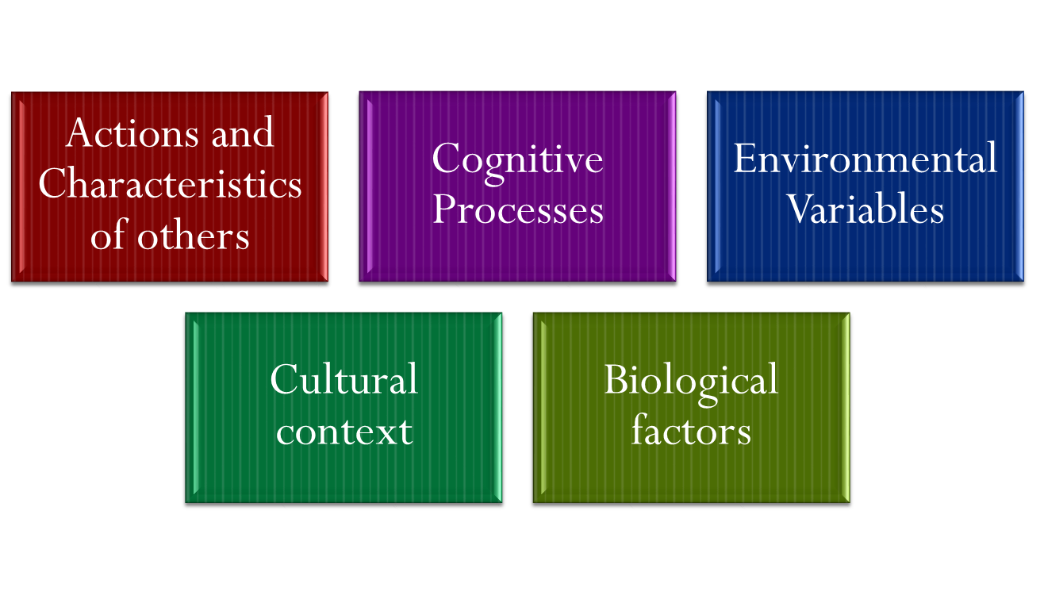
Factors Affecting Social Interaction

Slide 13
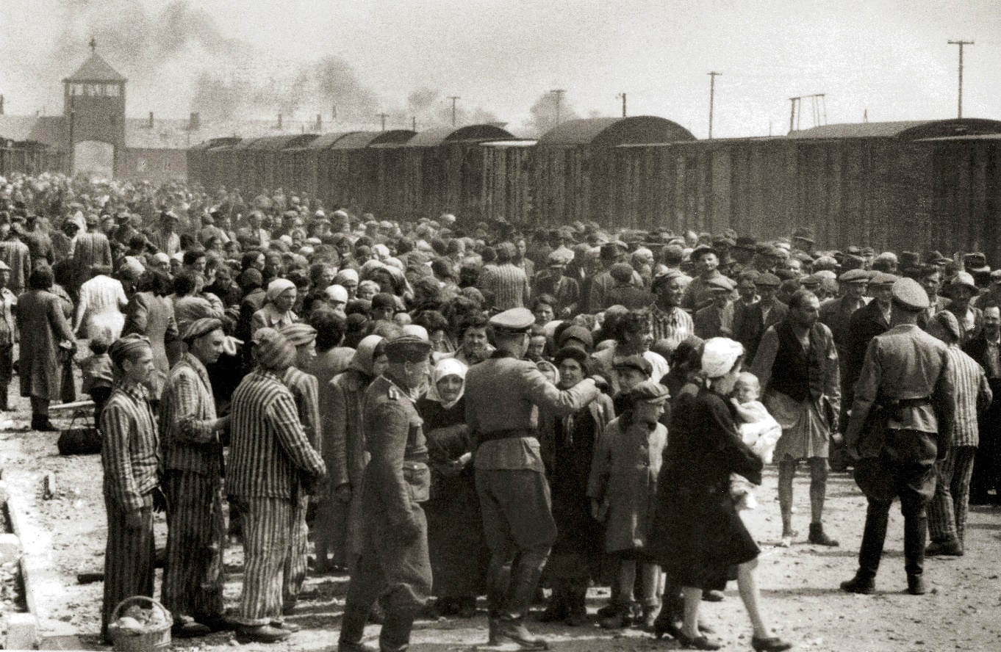
Main questions after World War II
The horrors of the Holocaust (destruction or slaughter on a mass scale, especially caused by fire or nuclear war) led researchers to study social influence, conformity, and obedience.
What could explain why people participated in such evil actions?
Were people following orders and
bowing to social pressure, or were
there some other forces at work?

Slide 14
Main concepts studied in Social Psychology
Social psychologists are interested in the impact that the social environment and group interactions have on attitudes and behaviors.
The main topics which social psychology covers:
Group behavior
Social perception
Leadership
Non verbal behavior
Conformity
Aggression
Prejudice
Attitude

Slide 15
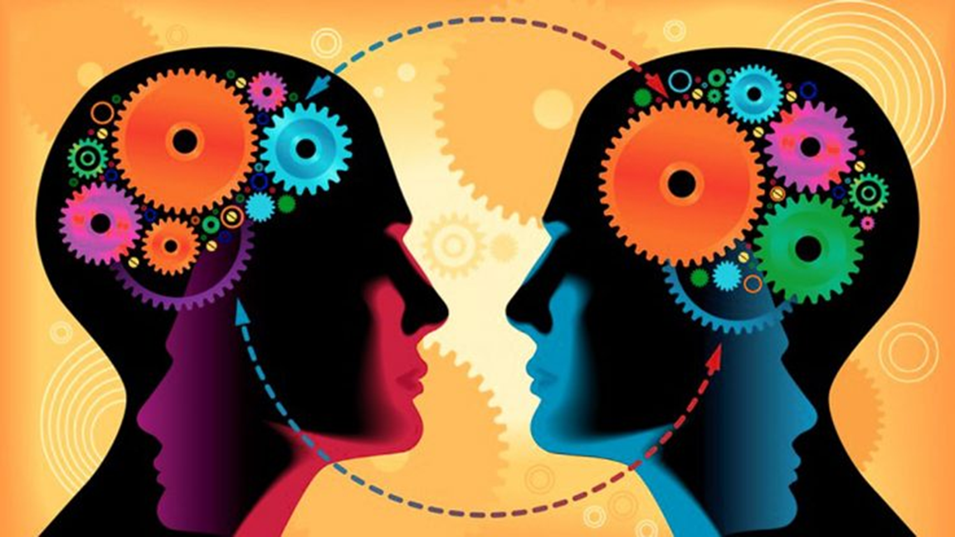
Attitudes
Evaluations of a particular person, behavior, belief, or concept, or “a tendency to respond positively or negatively toward a certain idea, person, object, or situation” (Triandis, 1971).
Characteristics
They tend to persist unless something is done to change them.
Notes:
https://www.verywellmind.com/attitudes-how-they-form-change-shape-behavior-2795897#:~:text=In%20psychology%2C%20an%20attitude%20refers,enduring%2C%20they%20can%20also%20change.

Slide 16
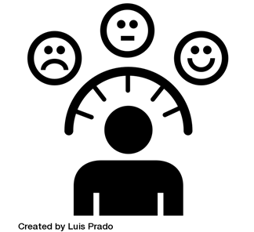
Why Study Attitudes?
Strongly influence our thought
help to organize and evaluate situations ( positive or negative)
Sometimes they have a strong affect on behavior
help to predict people’s behavior in wide range of contexts (e.g., relationships, voting)

Slide 17
How Psychologists Define Attitudes
Attitudes are Learned tendency to evaluate things in a certain way is called attitude.
Evaluations include of:
People, issues, objects, or events.
Such evaluations are often positive or negative, but they can also be uncertain at times.

Slide 18
Explanation
An attitude involves making a decision or an evaluation concerning liking vs. disliking, approving vs. disapproving or favoring vs. disfavoring a particular issue, object or person.
Different peoples can have different attitude towards a same things or ideas.
.

Slide 19
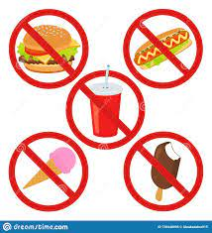
EXAMPLE OF NEGATIVE ATTITUDE:
We come across different people, Idea ,thing and situation. We may from a positive or negative views of them in our mind.
If I think that junk food are unhealthy at it has high sugar and fats.
It means I have negative attitude towards junk food consumption

Slide 20
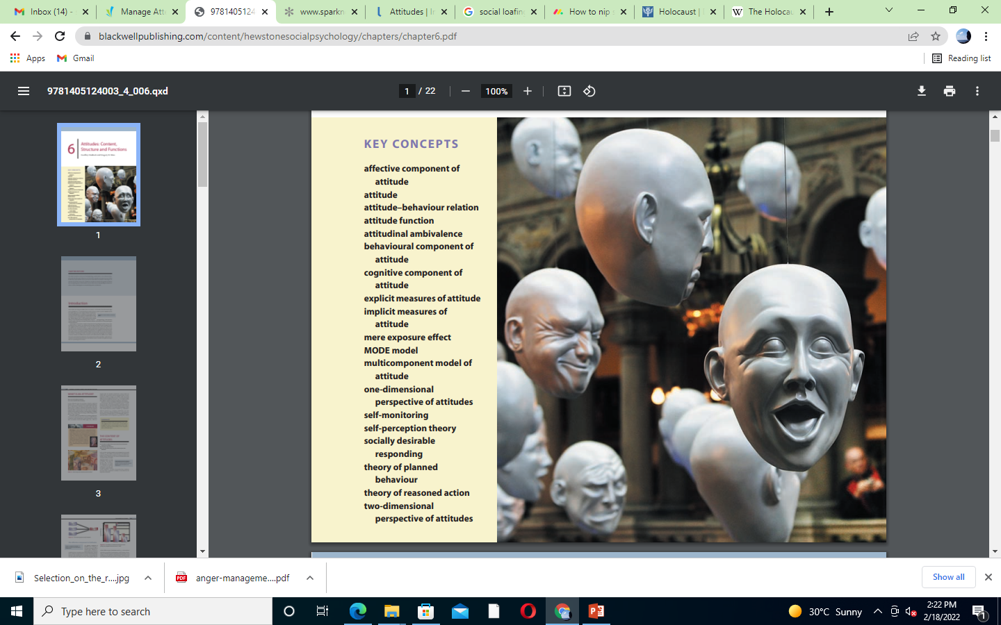
Components of Attitude
Psychologist such as Rosenber, Eagley and Hovland have given a three components model of Attitude.
According to this model an Attitude has following three components:
• Cognitive component
(our thoughts and beliefs about the subject)
• Affective component
(How the object, person, issue, or event makes you feel)
• Behavioral component
(How attitude influences your behavior)
ABC Model of Attitude.

Slide 21
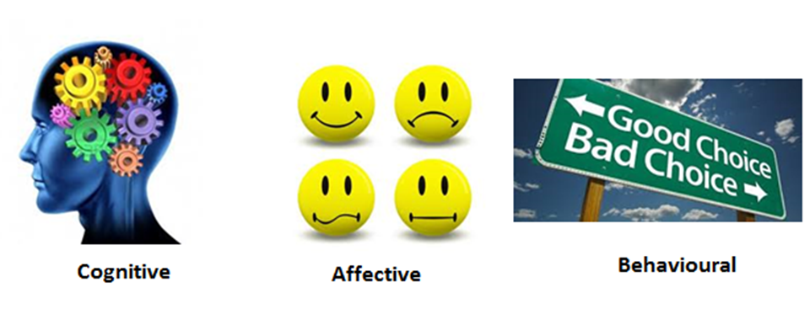
Scenario S” believes that smoking is unhealthy, feels disgusted when people smoke around her, and avoids being in situations where people smoke.
component of attitude

Slide 22
Scenario S” believes that smoking is unhealthy, feels disgusted when people smoke around her, and avoids being in situations where people smoke.
component of attitude

Slide 23
Scenario S” believes that smoking is unhealthy, feels disgusted when people smoke around her, and avoids being in situations where people smoke.
component of attitude

Slide 24
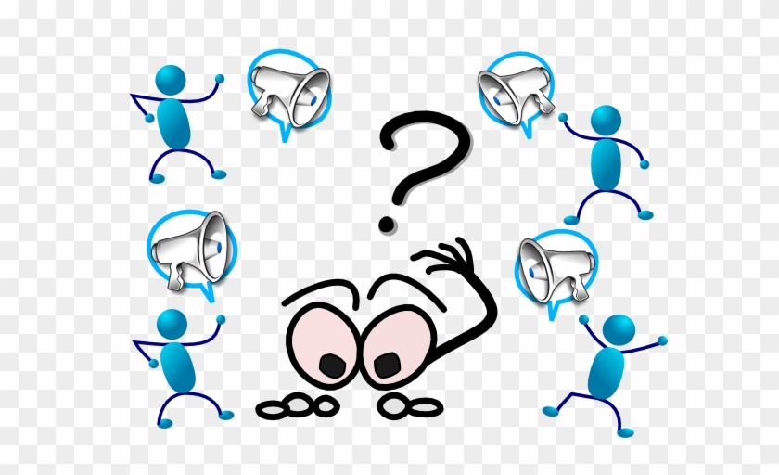
HOW OUR ATTITUDES ARE FORMED?

Slide 25


Would you rather watch a new movie, or an old favorite????? Would you rather try a dish you’ve never had at a restaurant, or stick with something you know you’ll like?????

Slide 26
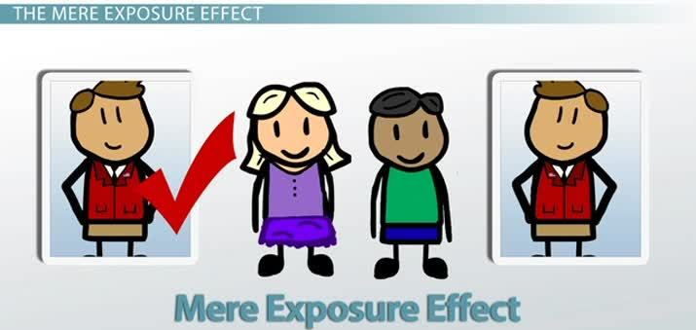
Mere Exposure
In1968, Social Psychologist Robert Zajonc’s hypothesis was that simply being exposed to something on a repeated basis was enough to make people like that thing.”
The tendency to develop more positive feelings toward objects and individuals the more we are exposed to them.
“A psychological phenomenon by which people tend to develop a preference for things or people that are more familiar to them than others.
Repeated exposure increases familiarity. This effect is therefore also known as the familiarity principle.”
Notes:
Franzoi, S. (2003). Social Psychology. Boston: McGraw-Hill. Chapter 6

Slide 27

He experimented by showing participants various
representations such as foreign words, faces of
strangers and Chinese characters.
Some of the participants had seen these once before, others many times, while some were viewing them for the first time.
After they were presented, Zajonc asked them to rate the images' levels of pleasantness.
Findings of the study:
Across the board, those who had seen the images previously liked it the most.
Participants favored the particular stimulus that they are more exposed to.

Slide 28
Self-perception theory (Bem, 1965)
Self-perception theory says that, 'When people are unsure about their feelings and motivations, they will use their own behavior to infer what they feel.' (i.e., behaviors can cause attitudes)
Self-perception theory predicts that acting would lead to feeling.
Examples:
“This is my second sandwich; I guess I was hungrier than I thought,” or,
“I’ve been biting my nails all day; something must be bugging me.”
Self-perception theory predicts that acting would lead to feeling.

Slide 29
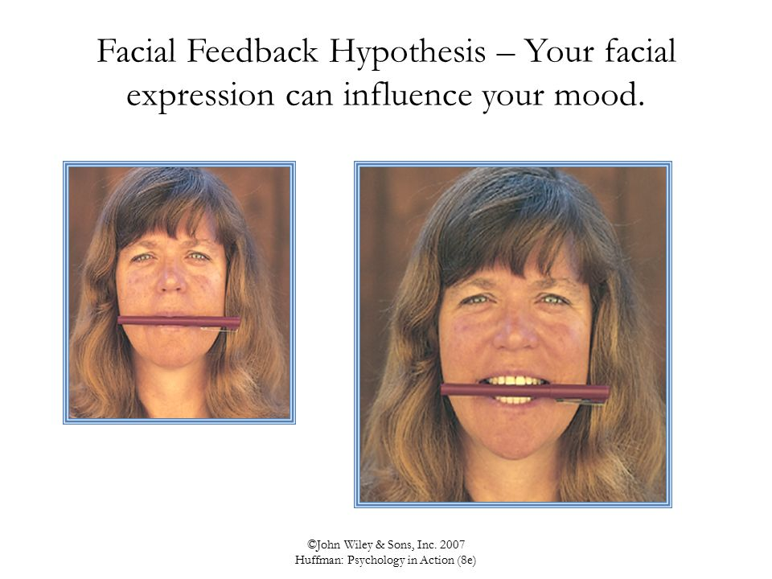
Facial feedback theory
The facial feedback hypothesis states that our facial expressions affect our emotions.
Strack, Martin, & Stepper (1988) conducted a study to understand the impact of facial expression and movement on attitude. In this paradigm, participants are instructed to hold a pen in their mouth either with their lips or with their teeth. Holding the pen with the teeth is supposed to activate the muscles involved in smiling. Holding the pen with the lips prevents smiling. Later their attitude toward cartoons was asked.
• Pen in teeth (like smiling) vs. Pen in lips (prevents smiling) • Pen in teeth -----> greater liking of the attitude object (cartoon)
This indicates facial feedback hypothesis.

Slide 30
HOW ATTITUDE CHANGE?

Slide 31
Describe the motivational and external sources for changing attitudes
Describe source variables that influence the effectiveness of persuasive messages

Slide 32
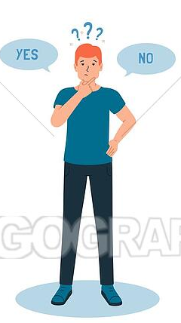
COGNITIVE DISSONANCE

Slide 33
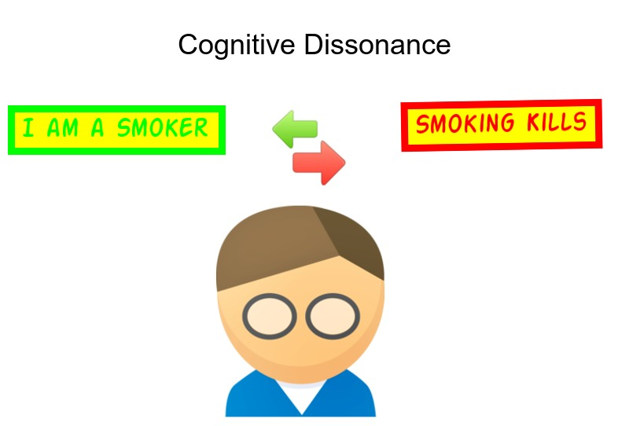
Cognitive dissonance theory (Festinger, 1957)
Cognitive= thought Dissonance= conflict
“The mental conﬂict that take place when a person holds two contradictory (opposite) attitudes or thoughts and feels emotional discomfort”.
Cognitive dissonance is attitude change via an Internal discrepancy.
To reduce the dissonance, either the person
1.Gives up the smoking
2.Give excuses about smoking

Slide 34
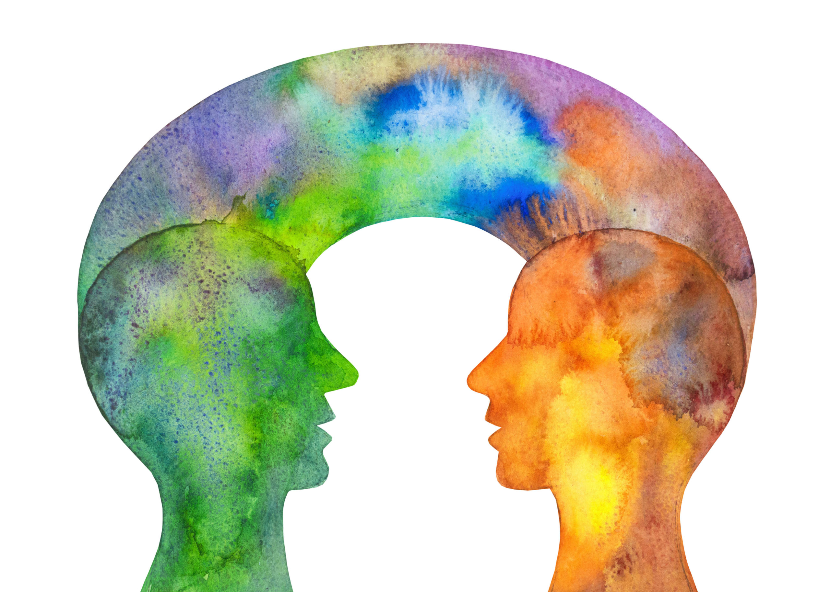
PERSUASION

Slide 35
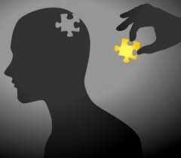
Persuation
Persuasion is defined as efforts made to change the other persons attitudes towards something
A symbolic process in which communicators try to convince other people to change their attitudes or behaviors regarding an issue
The act of convincing
Persuasion is attitude change via an external message
For example: Good salespeople use persuasion to get people to buy things.

Slide 36
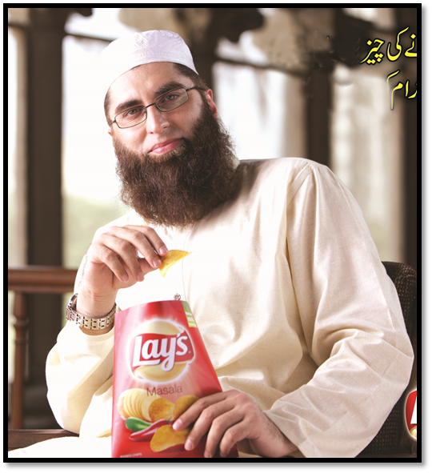
How Attitudes are changed through persuation
1. Through Credible communicators ( more persuasive)

Slide 37
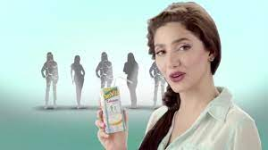
2.Attractive communicators

Slide 38

CONFORMITY

Slide 39
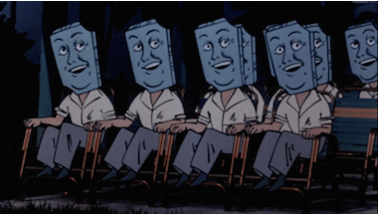
Conformity: Following What Others Do
“A type of social influence involving a change in a belief/ attitude or behavior in order to fit in with a group”
For example: Someone does not know the answer to a question, so ends up saying what the rest of the crowd says due to lack of knowledge.

Slide 40
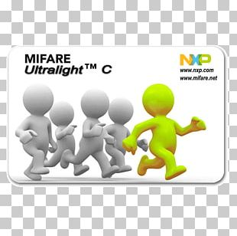
Types of Conformity
Informational Conformity
Going along with the group because you think they know more than you do.
Lack of knowledge leads someone to agree with the group
Normative Conformity
Yielding to group pressure just to fit in with the group.
Going along with the group so they will like you.

Slide 41
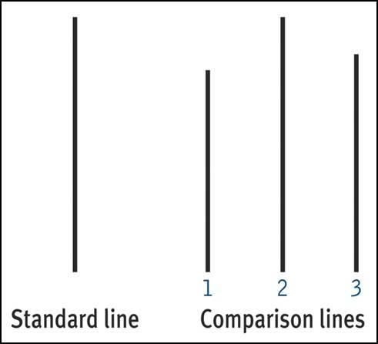
Solomon Asch’s line experiment
Involving 50 male students from Swarthmore College (USA) in a vision test.
Students were tested on the length of a line relative to another line.
Participants had confederates around them who intentionally gave wrong answers to see if the participant would agree with them.

Slide 42
Conclusion: People will conform to the group answer even when it is clearly incorrect.
About 75% of participants conformed and 25% of participants never conformed.
These results suggest that conformity can be influenced both by a need to fit in and a belief that other people are smarter or better informed.
https://www.youtube.com/watch?v=TYIh4MkcfJA
(video link of experiment)

Slide 43


Slide 44
Why did the participants conform so readily?
When they were interviewed after the experiment, most of them said that they did not really believe their conforming answers, but had gone along with the group for fear of being ridiculed or thought “weird".
A few of them said that they really did believe the group's answers were correct.

Slide 45
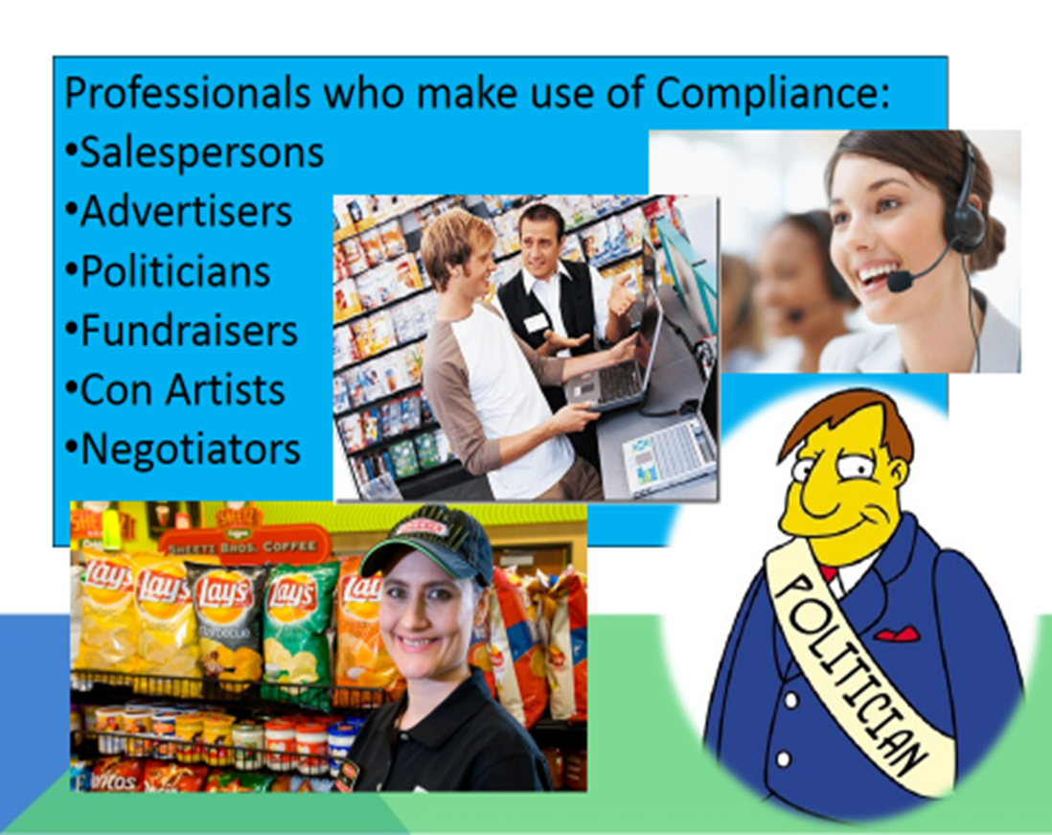
Compliance
Compliance: Submitting to Direct Social Pressure
Compliance is behavior that occurs in response to direct social pressure.
Getting people to say yes to a request

Slide 46

Obedience
A change in behavior in response to the commands of others.
Obedience as a form of social influence elicited in response to direct orders from an authority figure
Examples: A child who cleans his or her room when told to do so by a parent
A soldier who follows the orders of a superior officer.

Slide 47
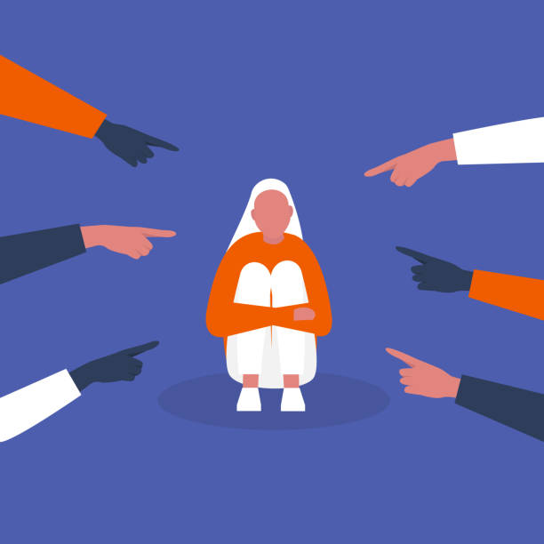
Prejudice
Literally means “prejudgment”
Unfavorable attitude towards a social group and its members.
It is the negative feelings experienced which are based solely on the person’s membership in a particular group.
The person is disliked for belonging to a specific group

Slide 48
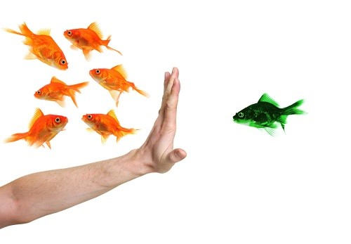
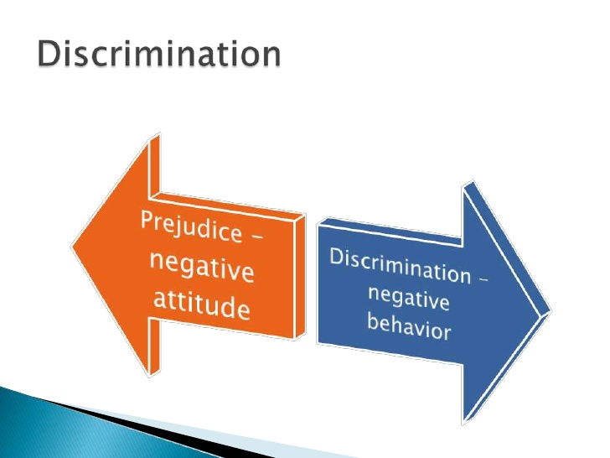
Discrimination
Harmful ACTIONS directed toward the persons or groups who are targets of prejudice.

Slide 49
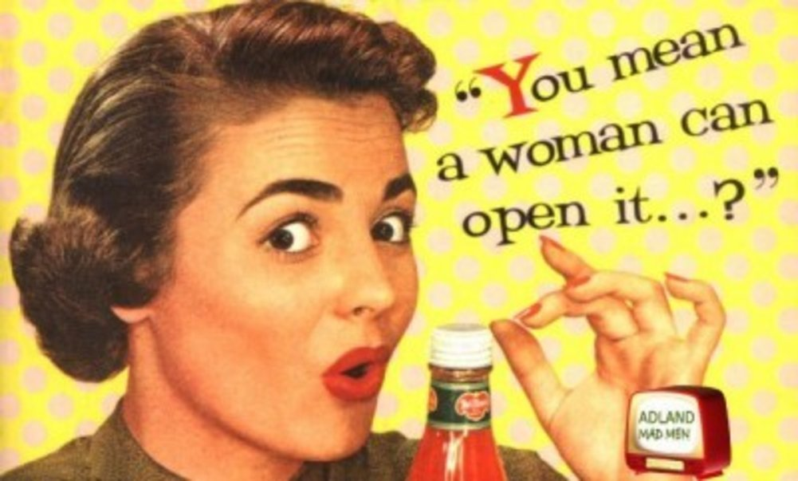
Stereotypes
Cognitive frameworks behind our attitudes. These are beliefs we hold about social groups.
Gender stereotypes concern traits are used to distinguish males and females from one another

Slide 50
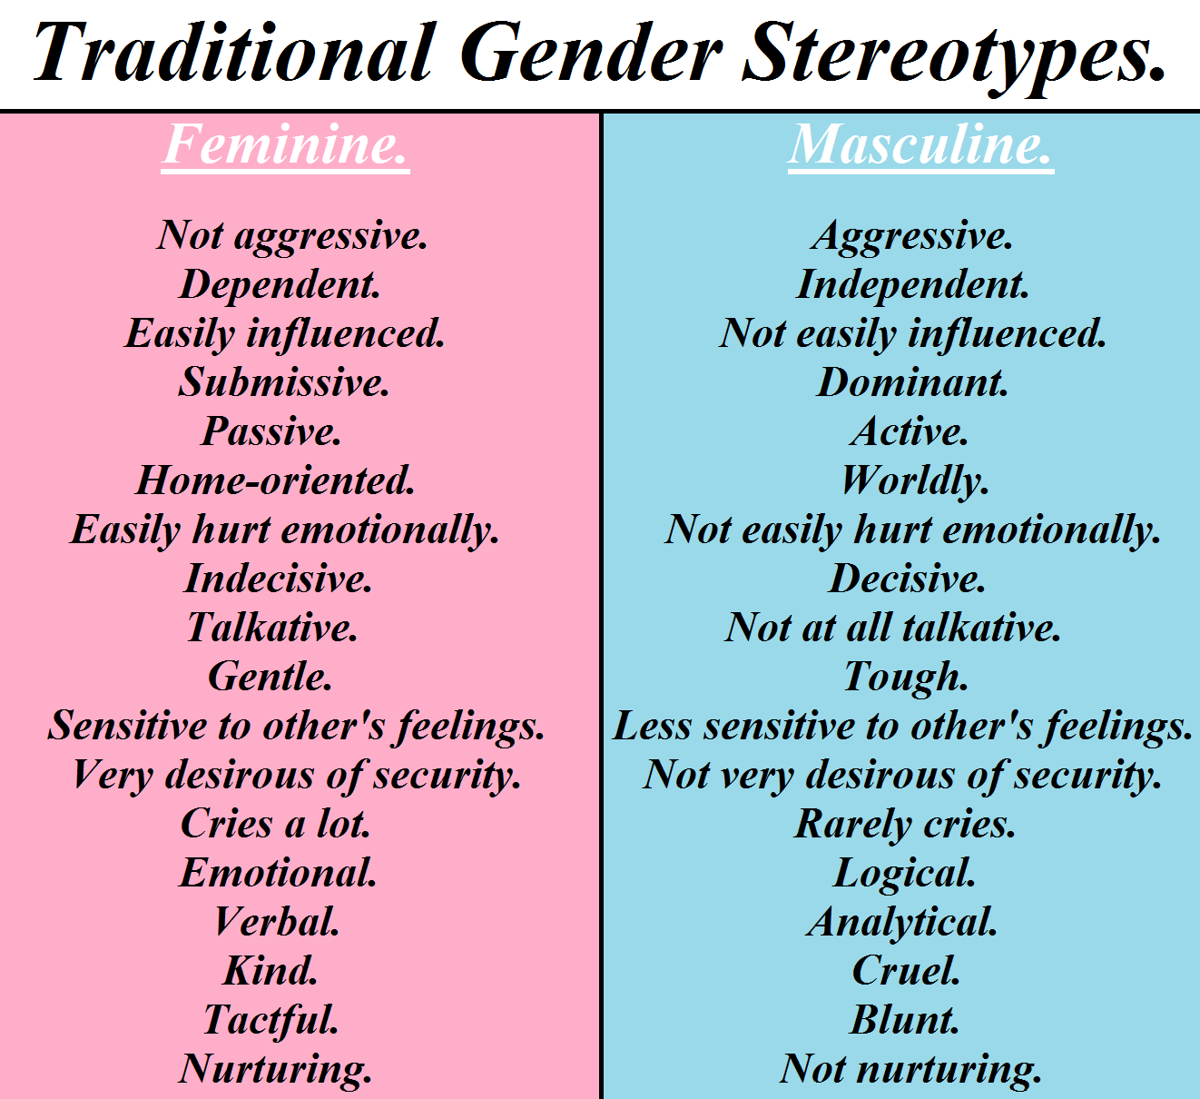

Slide 51


